Slide 1
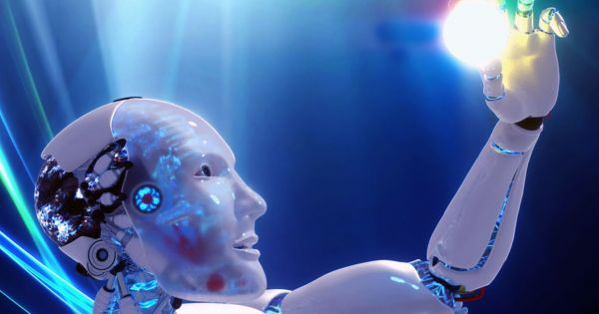
INTRODUCTION
TO
MACHINE LEARNING
PRESENTED BY :-
KISHAN KUMAR RAI
B.TECH,CSE
6TH SEM

Slide 2

Have You Ever Wondered ?
How Google classifies yours mails as Spam/Non-Spam?

Slide 3
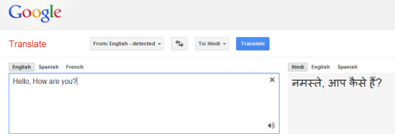
Have You Ever Wondered ?
How Google translate to more than 100 languages ?

Slide 4
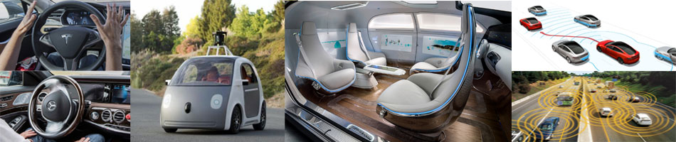
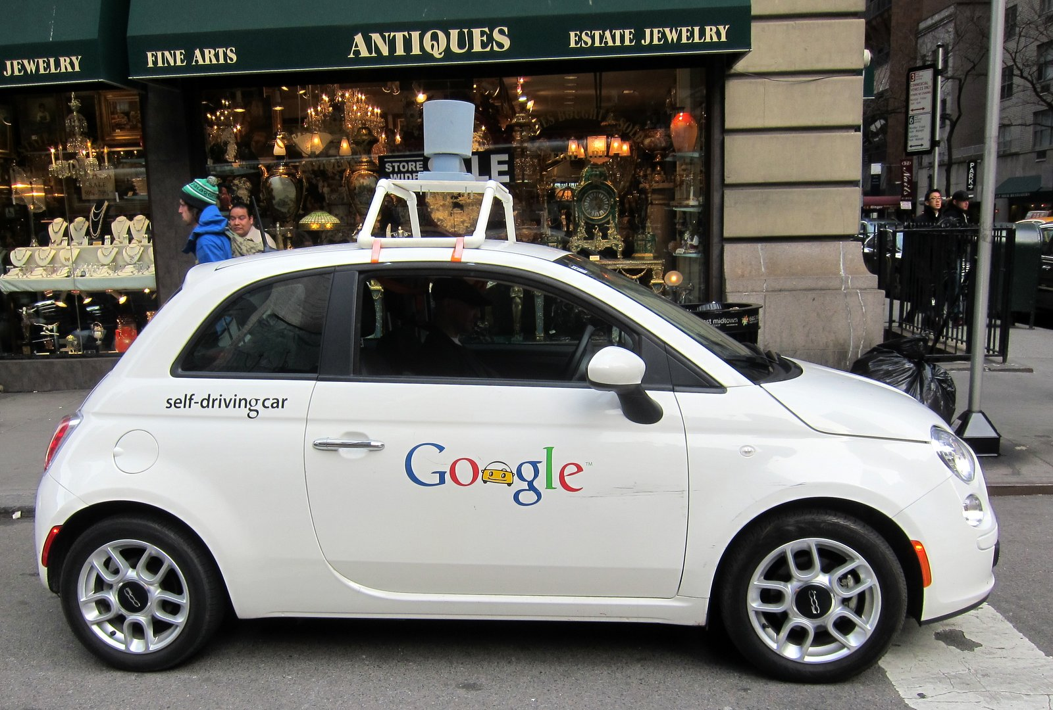
Have You Ever Wondered ?
How the Self-Driving cars are made ?

Slide 5

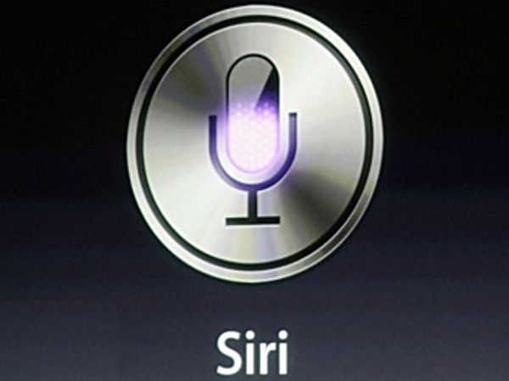
Have You Ever Wondered ?
How Siri, Cortana gives you correct replies ?

Slide 6
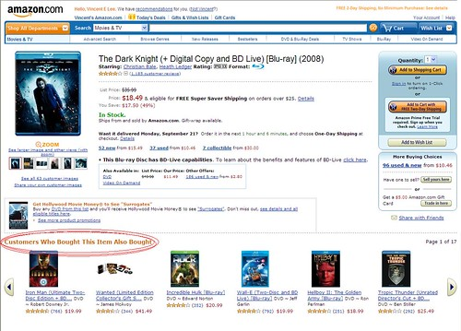
Have You Ever Wondered ?
How the products are recommended/advertises on sites ?

Slide 7
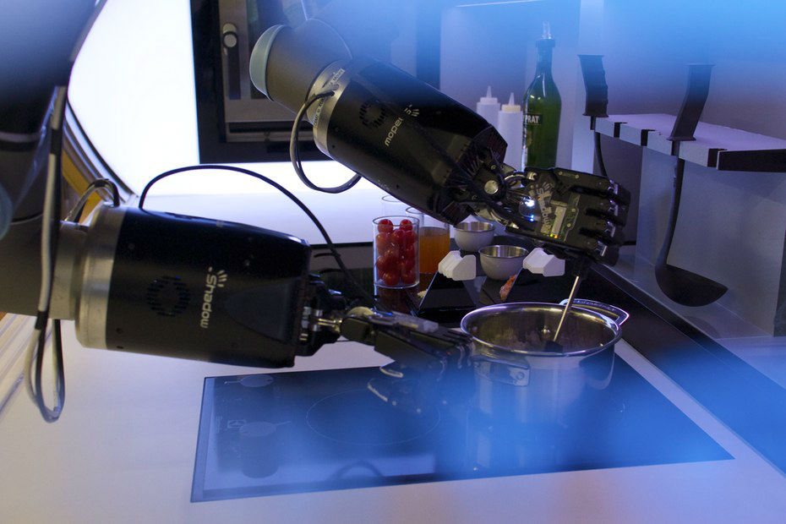
What
Is
Machine Learning ?

Slide 8
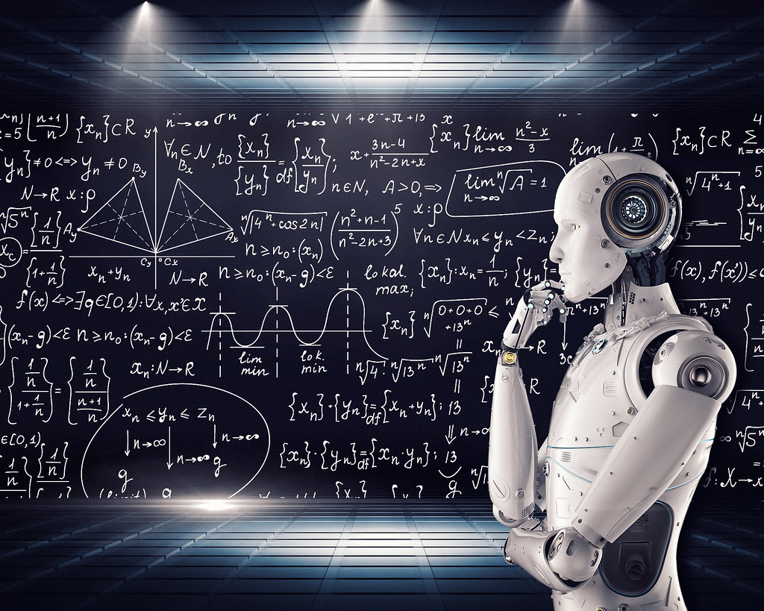
Machine Learning is the subfield
of the Artificial intelligence(AI)that
provides system the ability to automatically learn and improve from experience without being explicitly programmed.
Machine Learning focuses on the development of computer program that can access the data and use it learn for themselves.

Slide 9
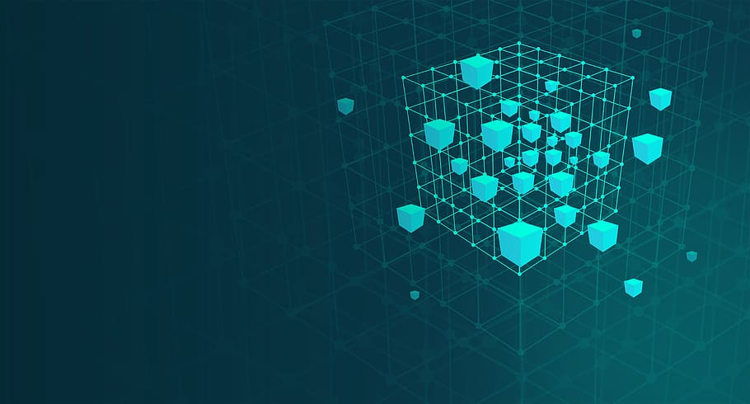
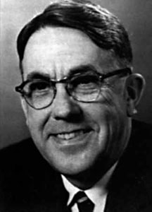
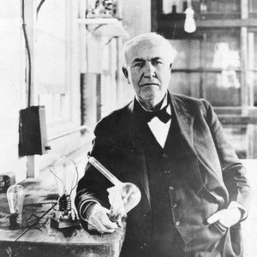
History of Machine Learning
The term Machine Learning was coined by Arthur Samuel in 1959, an American pioneer in the field of computer gaming and artificial intelligence and stated that
“It gives computers the ability to learn without being explicitly programmed”.
And in 1997, Tom Mitchell gave a “well-posed” mathematical and relational definition that
“A computer program is said to learn from experience E with respect to some task T and some performance measure P, if its performance on T, as measured by P, improves with experience E.”

Slide 10
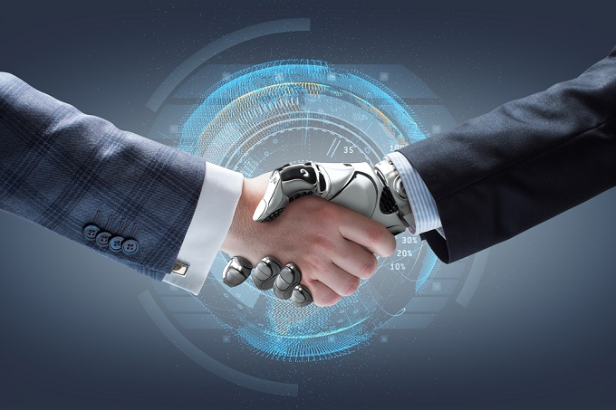
Why Do We Need Machine Learning?

Slide 11
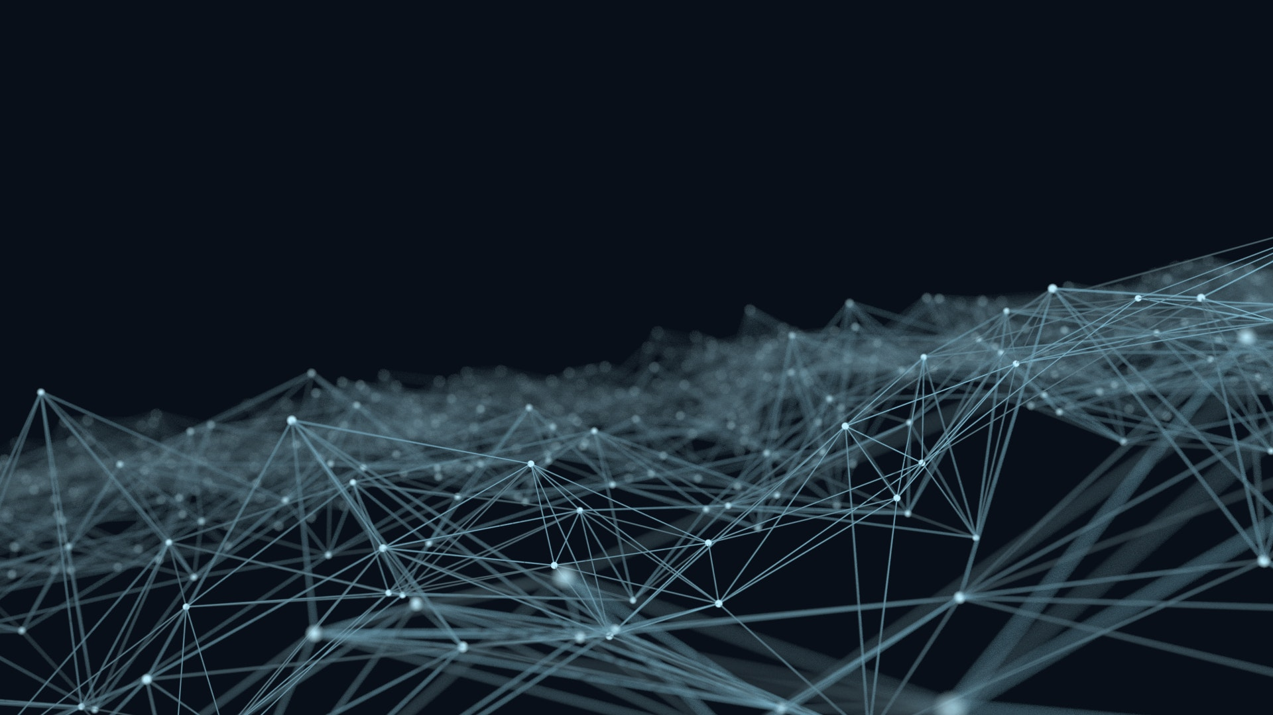
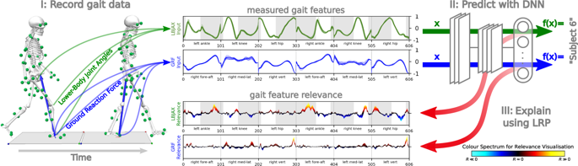
We need machine learning for tasks that are too complex for humans to code directly, i.e. tasks that are so complex that it is impractical, if not impossible, for us to work out all of the nuances and code for them explicitly. So instead, we provide a machine learning algorithm with a large amount of data and let it explore and search for a model that will work out what the programmers have set out to achieve.
Let’s look at these two examples:
It’s very hard to write programs that solve problems like recognizing a 3D object, from a novel viewpoint, in new lighting conditions, in a cluttered scene. We don’t know what program to write because we don’t know how it’s done in our brain. Even if we had a good idea for how to do it, the program might be horrendously complicated.
It’s hard to write a program to compute the probability that a credit card transaction is fraudulent. There may not be any rules that are both simple and reliable. We need to combine a very large number of weak rules. Fraud is a moving target, but the program needs to keep changing.

Slide 12
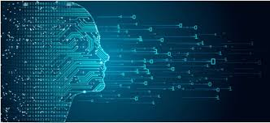
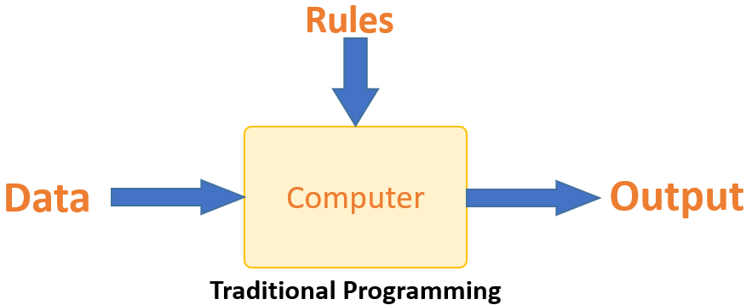
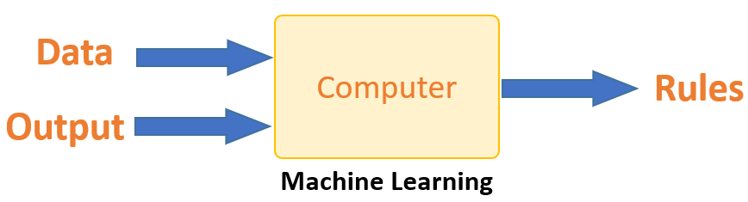
Machine learning vs traditional learning
Traditional programming differs significantly from machine learning. In traditional programming, a programmer code all the rules in consultation with an expert in the industry for which software is being developed. Each rule is based on a logical foundation; the machine will execute an output following the logical statement. When the system grows complex, more rules need to be written. It can quickly become unsustainable to maintain.
Machine learning is supposed to overcome this issue. The machine learns how the input and output data are correlated and it writes a rule. The programmers do not need to write new rules each time there is new data. The algorithms adapt in response to new data and experiences to improve efficacy over time.

Slide 13
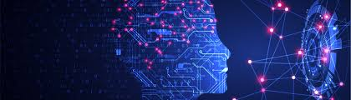

How does Machine learning work?
Machine learning is the brain where all the learning takes place. The way the machine learns is similar to the human being. Humans learn from experience. The more we know, the more easily we can predict. By analogy, when we face an unknown situation, the likelihood of success is lower than the known situation. Machines are trained the same. To make an accurate prediction, the machine sees an example. When we give the machine a similar example, it can figure out the outcome. However, like a human, if its feed a previously unseen example, the machine has difficulties to predict.
The life of Machine Learning programs is straightforward and can be summarized in the following points:
Define a question
Collect data
Visualize data
Train algorithm
Test the Algorithm
Collect feedback
Refine the algorithm
Loop 4-7 until the results are satisfying
Use the model to make a prediction

Slide 14
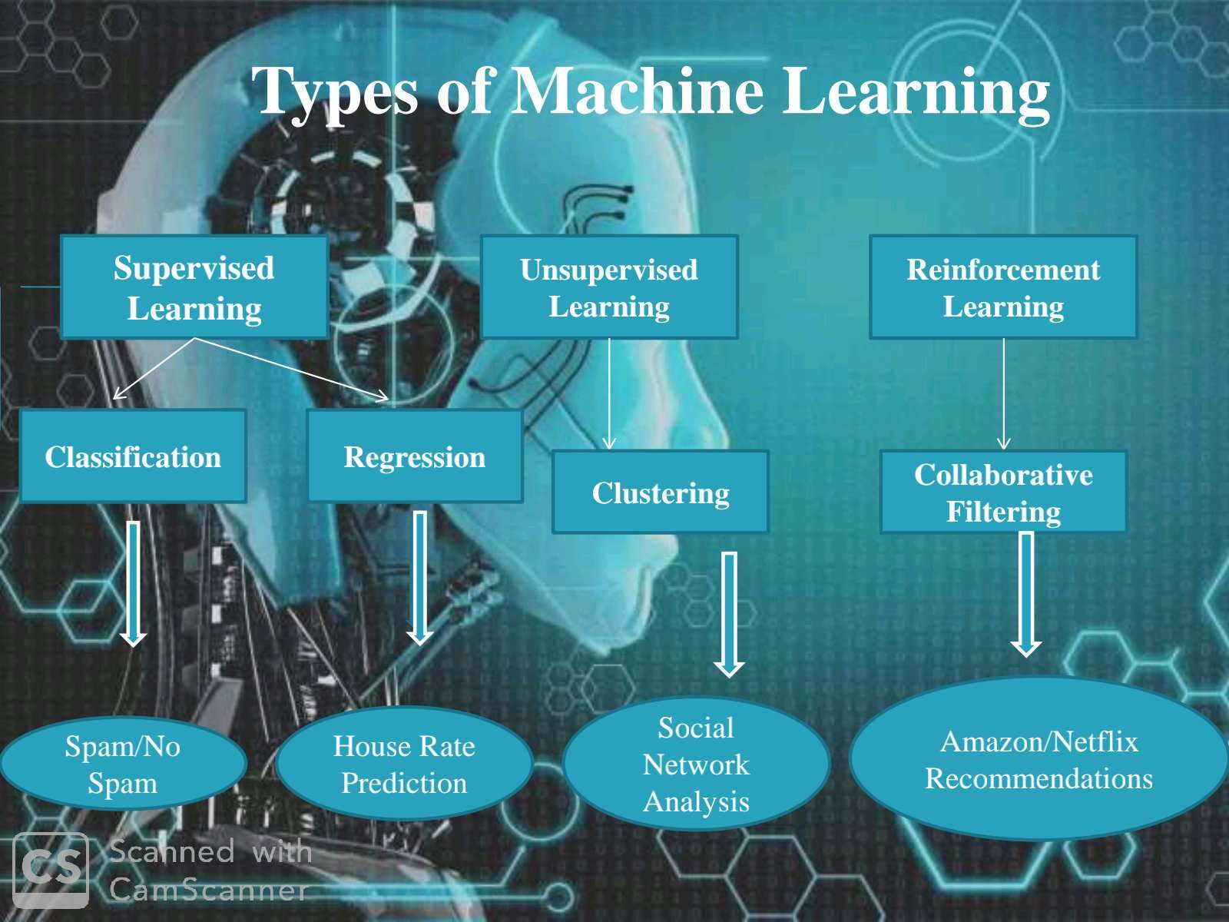

Slide 15
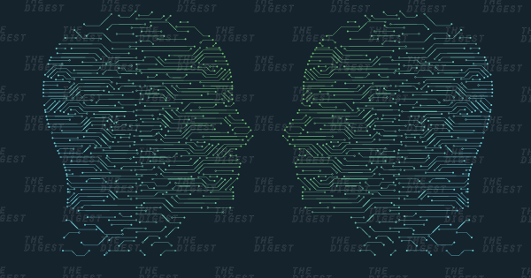
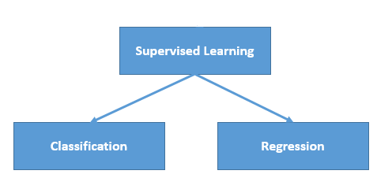
Supervised machine learning
algorithms can apply what has been learned in the past to new data using labeled examples to predict future events. Starting from the analysis of a known training dataset, the learning algorithm produces an inferred function to make predictions about the output values. The system is able to provide targets for any new input after sufficient training. The learning algorithm can also compare its output with the correct, intended output and find errors in order to modify the model accordingly.
Key points:
Regression and classification problems are mainly solved here.
Labelled data is used for training here.
Popular Algorithms: Linear Regression, Support Vector Machines (SVM), Neural Networks, Decision Trees, Naive Bayes, Nearest Neighbor.
It is mainly used in Predicting Modelling.

Slide 16
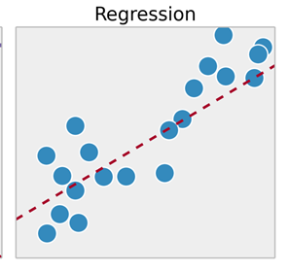
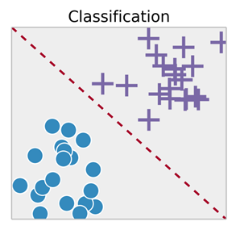
Regression:
This is a type of problem where we need to predict the continuous-response value (ex : above we predict number which can vary from -infinity to +infinity).
Some examples are :
what is the price of house in a specific city?
what is the value of the stock?
how many total runs can be on board in a cricket game?
etc… there are tons of things we can predict if we wish.
Classification:
This is a type of problem where we predict the categorical response value where the data can be separated into specific “classes” (ex: we predict one of the values in a set of values).
Some examples are :
this mail is spam or not?
will it rain today or not?
is this picture a cat or not?
Basically ‘Yes/No’ type questions called binary classification.
Other examples are :
this mail is spam or important or promotion?
is this picture a cat or a dog or a tiger?
This type is called multi-class classification.

Slide 17
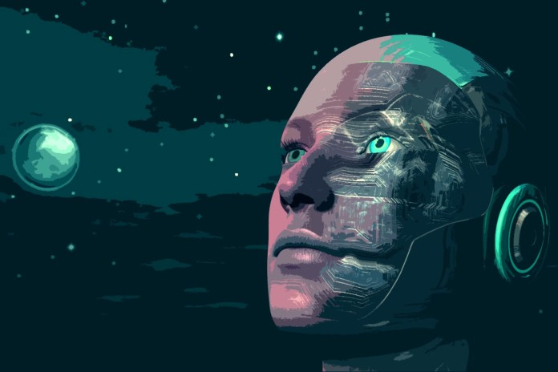
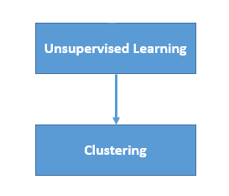
unsupervised machine learning
algorithms are used when the information used to train is neither classified nor labeled. Unsupervised learning studies how systems can infer a function to describe a hidden structure from unlabeled data. The system doesn’t figure out the right output, but it explores the data and can draw inferences from datasets to describe hidden structures from unlabeled data.
Key points:
It is used for Clustering problems(grouping), Anomaly Detection (in banks for unusual transactions) where there is a need for finding relationships among the data given.
Unlabeled data is used in unsupervised learning.
Popular Algorithms: k-means clustering, Association rule.
It is mainly used in Descriptive Modelling.

Slide 18
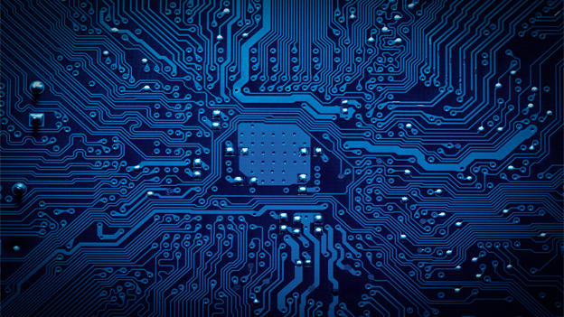
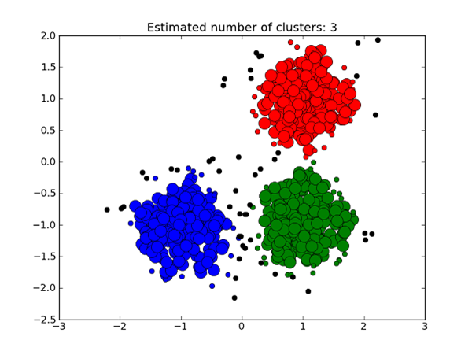
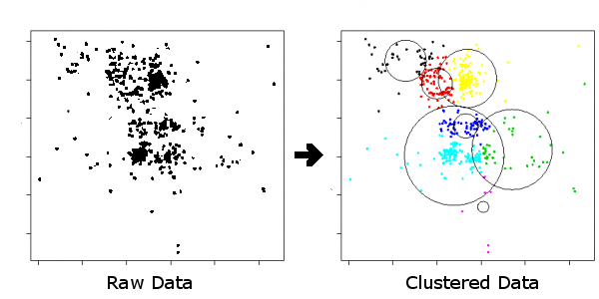
Clustering:
This is a type of problem where we group similar things together.
Bit similar to multi class classification but here we don’t provide the labels, the system understands from data itself and cluster the data.
Some examples are :
given news articles,clustre into different types of news
given a set of tweets ,cluster based on content of tweet
given a set of images, cluster them into different objects

Slide 19
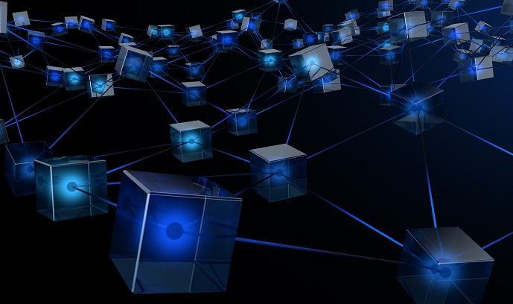
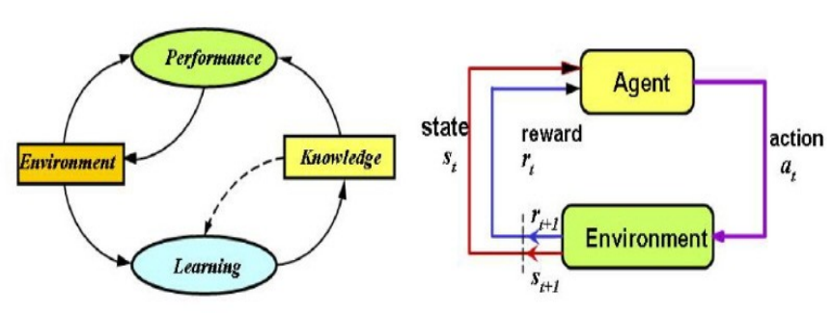
Reinforced Machine Learning:
The machine is exposed to an environment where it gets trained by trial and error method, here it is trained to make a much specific decision. The machine learns from past experience and tries to capture the best possible knowledge to make accurate decisions based on the feedback received.
Key points:
Basic reinforcement is modelled as Markov Decision Process
The most popular algorithms used here is Q-Learning, Deep Adversarial Networks.
Its practical applications include computer playing board games such as chess and GO, Self-driving cars also use this learning.

Slide 20
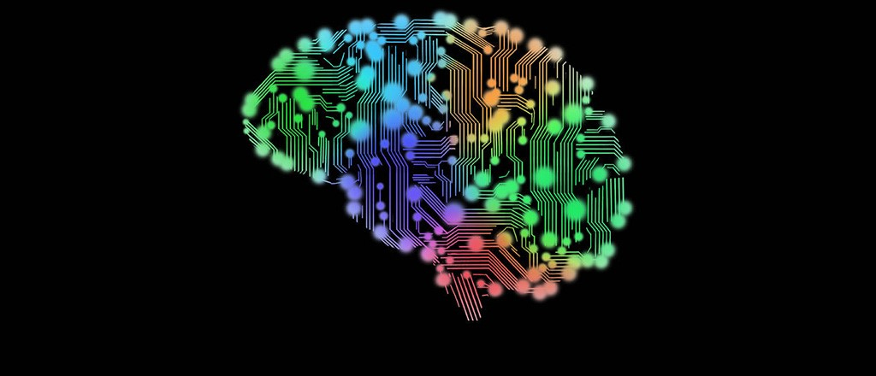
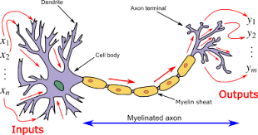
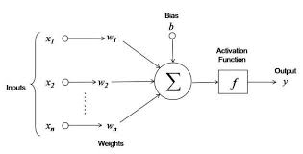
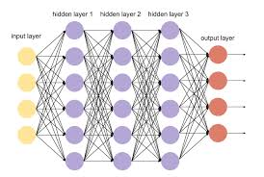
What are Neural Networks?
Neural Networks are a class of models within the general machine learning literature. Neural networks are a specific set of algorithms that have revolutionized machine learning. They are inspired by biological neural networks and the current so-called deep neural networks have proven to work quite well. Neural Networks are themselves general function approximations, which is why they can be applied to almost any machine learning problem about learning a complex mapping from the input to the output space.
Here are the three reasons you should study neural computation:
To understand how the brain actually works: it’s very big and very complicated and made of stuff that dies when you poke it, so we need to use computer simulations.
To understand a style of parallel computation inspired by neurons and their adaptive connections: it’s a very different style from sequential computation.
To solve practical problems by using novel learning algorithms inspired by the brain: learning algorithms can be very useful even if they are not how the brain actually works.

Slide 21
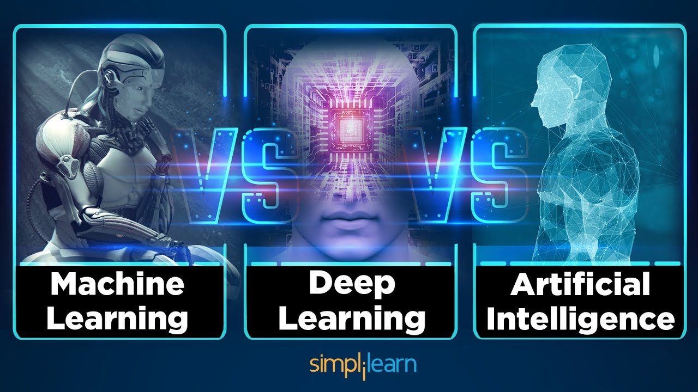

Slide 22
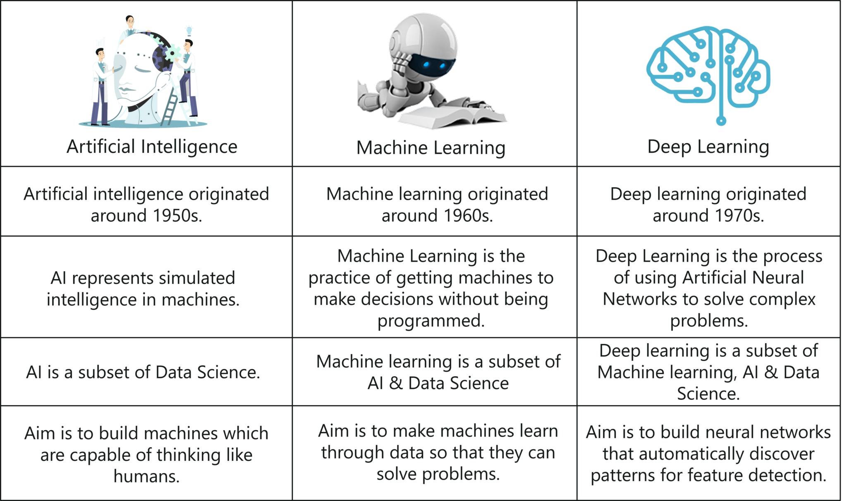
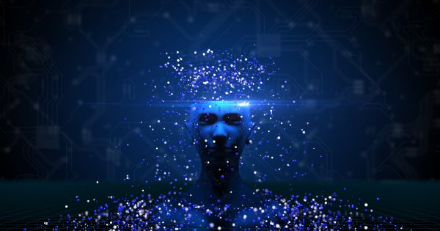
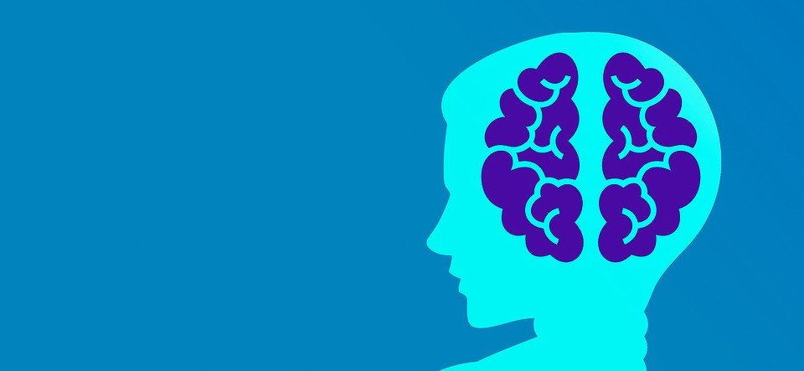
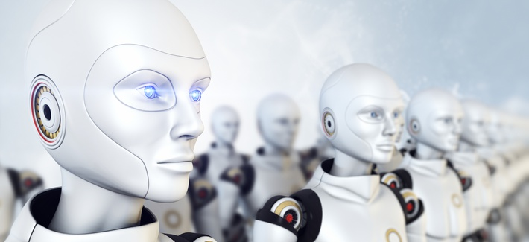

Slide 23
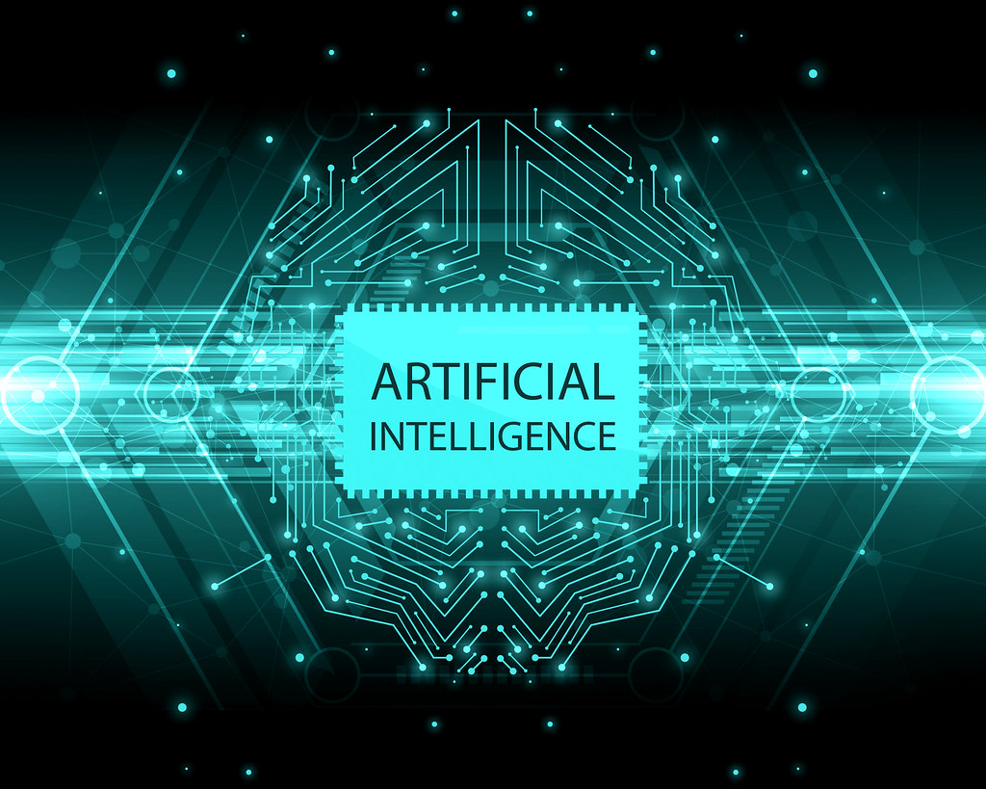
Applications
of
Machine Learning

Slide 24
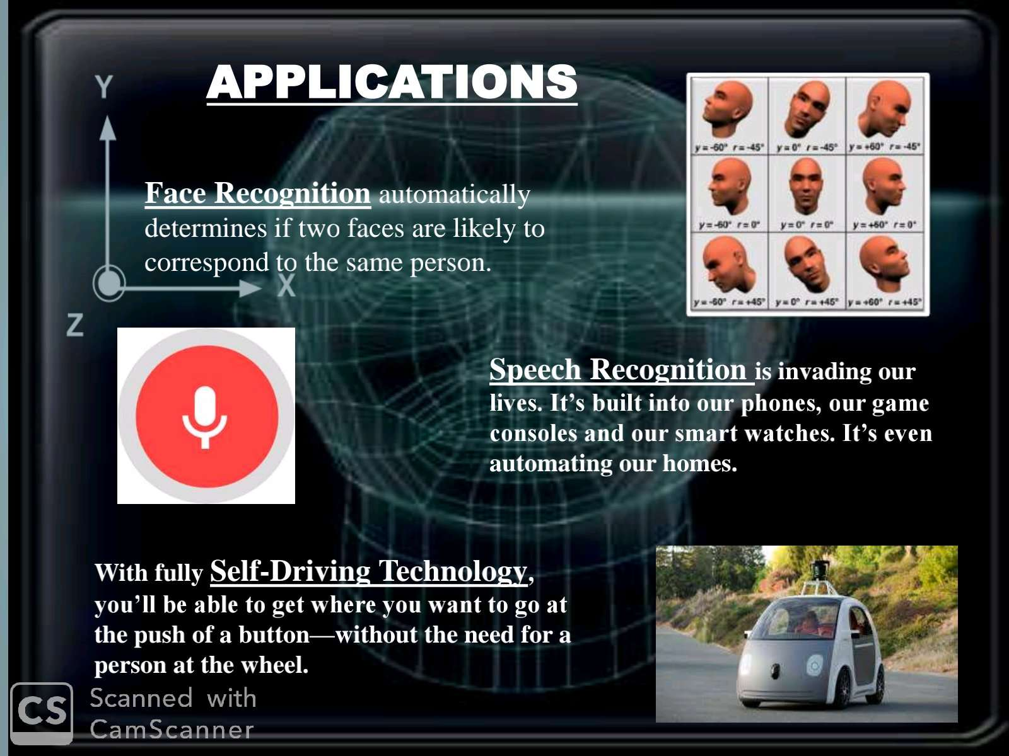
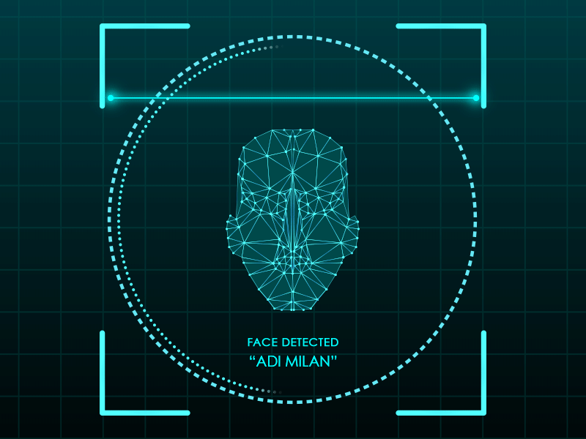

Slide 25

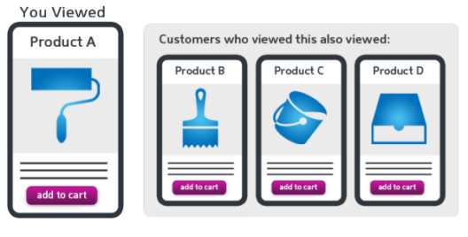
Traffic Alerts (Maps)
Now, Google Maps is probably THE app we use whenever we go out and require assistance in directions and traffic. The other day I was traveling to another city and took the expressway and Maps suggested: “Despite the Heavy Traffic, you are on the fastest route“. But, How does it know that?
Products Recommendations
Suppose you check an item on Amazon, but you do not buy it then and there. But the next day, you’re watching videos on YouTube and suddenly you see an ad for the same item. You switch to Facebook, there also you see the same ad. So how does this happen?

Slide 26
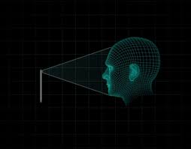
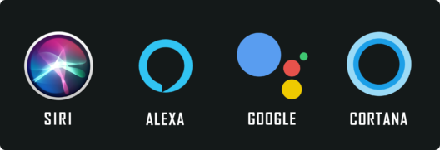

Virtual Personal Assistants
As the name suggests, Virtual Personal Assistants assist in finding useful information, when asked via text or voice. Few of the major Applications of Machine Learning here are:
Speech Recognition
Speech to Text Conversion
Natural Language Processing
Text to Speech Conversion
Self Driving Cars
Well, here is one of the coolest application of Machine Learning. It’s here and people are already using it. Machine Learning plays a very important role in Self Driving Cars and I’m sure you guys might have heard about Tesla. The leader in this business and their current Artificial Intelligence is driven by hardware manufacturer NVIDIA, which is based on Unsupervised Learning Algorithm.

Slide 27
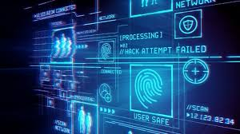
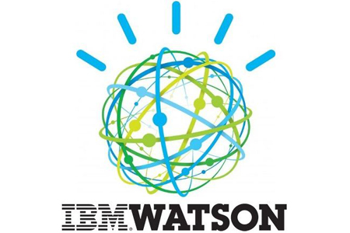
Machine Learning Achievement
In 2002, IBM develop the IBM WATSON which beats the two human in a game JEOPARDY.it
is the result of machine learning ,natural language processing and information retrieval technology.

Slide 28
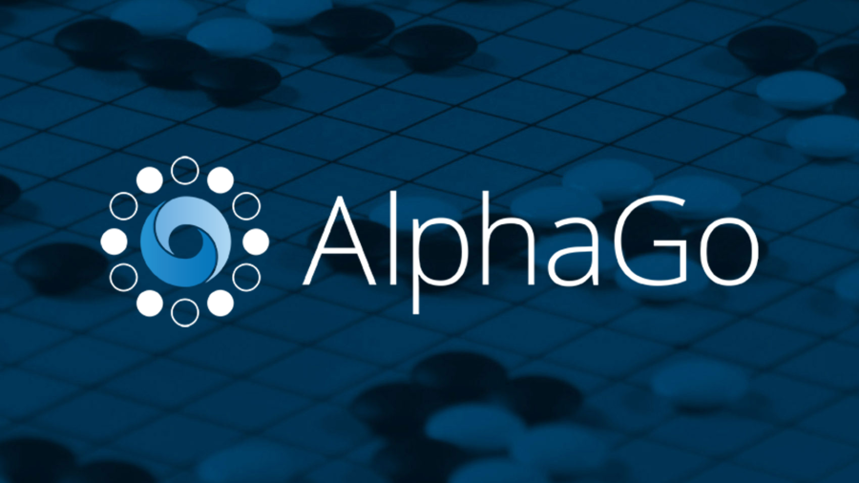
Machine Learning Achievement
In 2002, IBM develop the IBM WATSON which beats the two human in a game JEOPARDY.it
is the result of machine learning ,natural language processing and information retrieval technology.
In 2016,Google AlphaGo program become the first computer program to beat a professional human using the combination of Machine Learning and Tree Search Techniques.

Slide 29

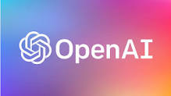

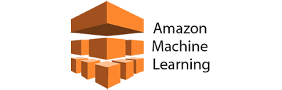



Machine Learning Achievement

Slide 30





Slide 31


